Slide 1



YOUTUBE DATA BASE ANALYSIS
by
Neelanjan Chakraborty

Slide 2






INTRODUCTION
Preliminary data exploration aims to gain a better understanding of the data's characteristics.
Key motivations for data exploration include:
Assisting in the selection of appropriate tools for preprocessing or analysis.
Leveraging human abilities to identify patterns that may not be captured by automated data analysis tools.
Exploratory Data Analysis (EDA), originally defined by statistician John Tukey, emphasizes:
Visualization as a primary focus for understanding the data.
Considering clustering and anomaly detection as exploratory techniques.
However, in the field of data mining, clustering and anomaly detection are significant areas of interest and not limited to exploratory purposes.
When discussing data exploration, we primarily focus on:
Obtaining summary statistics to summarize the data's key properties.
Utilizing visualization techniques to visually represent the data and identify patterns.
Employing Online Analytical Processing (OLAP) methods to facilitate interactive analysis of multi-dimensional data.

Slide 3
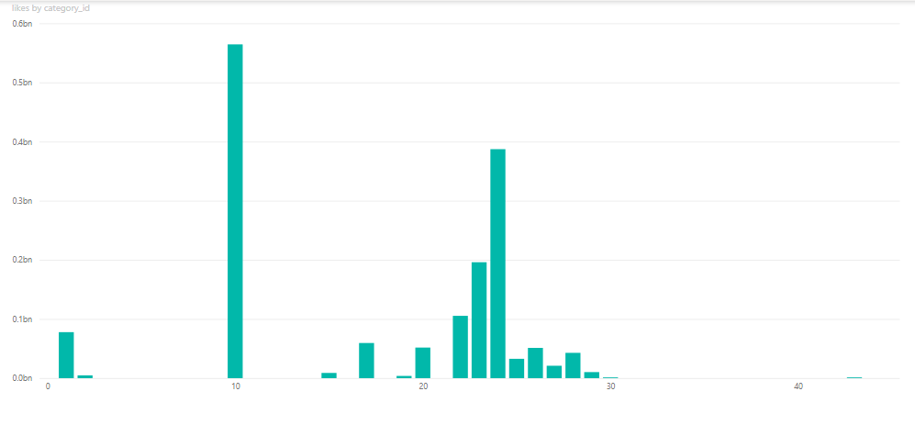
Graph -1(Category by Likes)
Here we can see like of Category 24 is so high, it means it is so demandable by the consumer. So we can make similar type of video to attract new consumer.Like wise category 43 is less demandable video so we should avoid to make it. Here can also see the categories which have the most content. As one could see entertainment is the leading category with the most content and followed by category25,10,22,23.So we can say people are using youtube for these to get some relaxation?

Slide 4
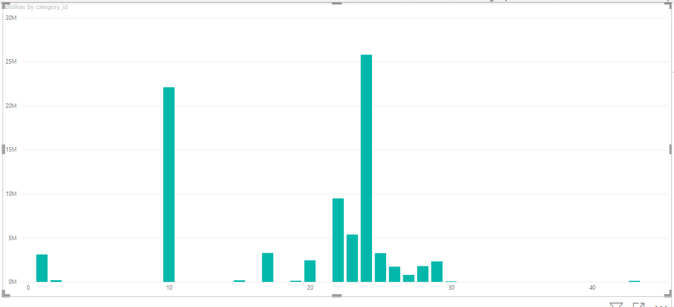
Graph -2(Category by dislikes)
Here we can category 24 is most dislike category And though category 10 is more like category also more dislike category and also category 24 is also more likeable category.So we should not replace it .Let them to continue.We can bring changes in something to increase the likingness of the consumer.

Slide 5
Graph -2(Category by dislikes)
Here we can category 24 is most dislike category And though category 10 is more like category also more dis like category and also category 24 is also more likeable category.So we should not replace it .Let them to continue.We can bring changes in something to increase the likingness of the consumer.

Slide 6
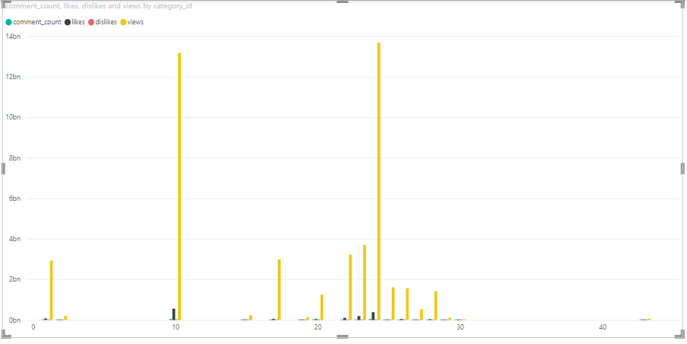
Graph 3- (category by comment,likes,dislikes)
Likes, dislikes, and comments distribution by category id; it can be seen that these attributes are correlated with views distribution except one category. Where likes are increasing Views are also increasing.
Graph -4(category by views)

Slide 7
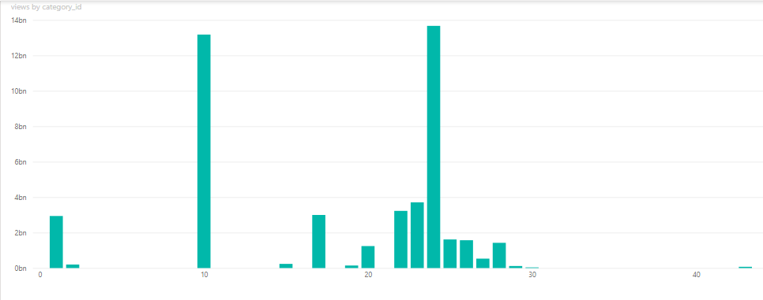
Graph -4(category by views)
Here we can see the most viewed category is 24 and category 40 is completely not watched

Slide 8
FINDINGS:
1. We have seen that most content is produced in the following categories:10,24,21,22 are demanded.
2. Most watched categories are 10,24
3. There are some categories that have fewer contents but still more views than some categories.
4. Views and likes attributes are highly correlated, just like dislikes and comments.
CONCLUSSION:
On the basis of this analysis we can decide on which category we can focus more and on which category we can focus less.

Slide 9
Thank you

